Slide 1
Confessions of an Environmental Racist
Troy D. Abel, PhD
Associate Professor of Environmental Policy, Huxley College of the Environment
April 11, 2017

Slide 2
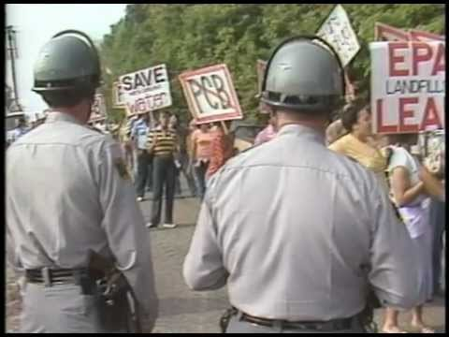
Toxic Racism
Concerns over environmental racism emerged in the 1980s when hazardous waste and toxic disposal policies intersected with civil rights.
Notes:
Warren County, North Carolina is described as the birthplace of the environmental justice movement (McGurty 1997, 2000; Newton 2009). Residents of this rural and predominantly African-American community had been in a three year fight over the state’s landfill permit application approved in 1979 by the EPA. In a seminal act of environmental civil disobedience, protestors laid across the road to block trucks carrying Polychlorinated Biphenyls (PCB} contaminated soil over a six week period and gained the attention of the national media and national civil rights leaders.
https://youtu.be/1iCxh0BYjgI
I hope you noticed how the protest was multiracial.

Slide 3
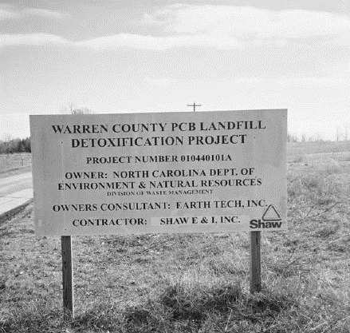
Key Terms
Environmental Justice
“fair treatment of people of all races, cultures, and incomes with respect to the development, implementation and enforcement of all environmental laws and policies and their meaningful involvement in the decision making processes of the government.”

Slide 4
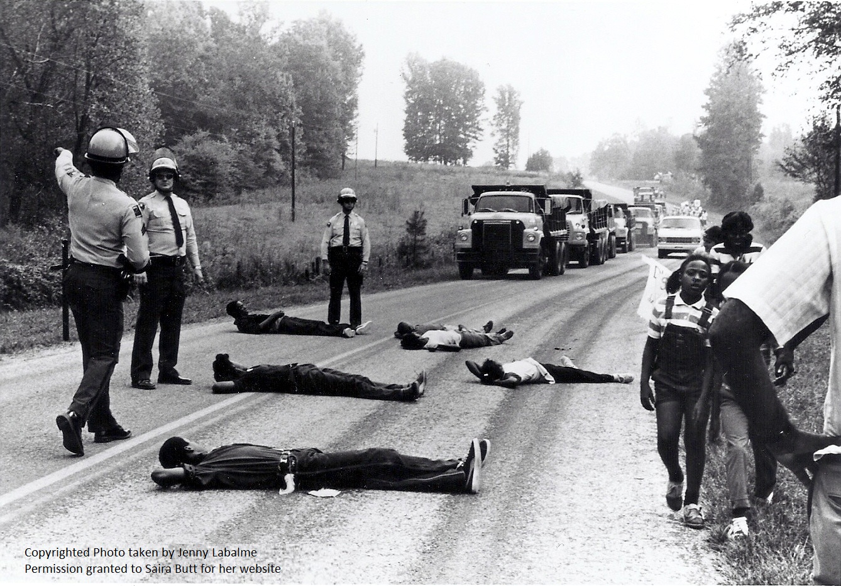
Key Terms
Environmental racism
The unfair treatment and meaningless involvement of people in the development, implementation, and enforcement of environmental laws and policies because of their race.
Notes:
Numerous studies found environmental injustice where the geographic distributions of environmental hazards and low-income and minority populations are not random; they cluster together in many US places.

Slide 5
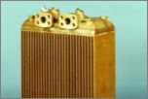
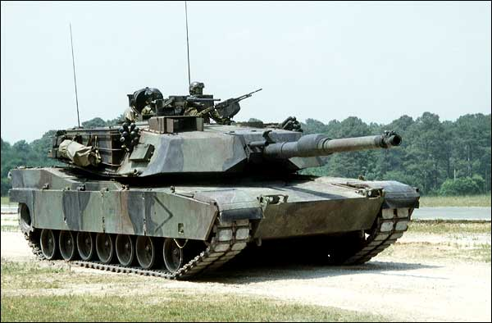
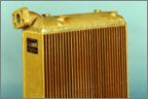
My Racial Illiteracy
1987, I interned at Stewart Warner Southwind in Indianapolis, IN.
Notes:
In my early twenties, I found an internship in 1987 with a local manufacturing facility working with a safety engineer at the Stewart Warner Southwind company in Indianapolis, IN. They specialized in vehicle and aircraft heaters and radiators. A name surely derived from how a south wind is hotter than the rest in most cases. Our country was preparing for the first Gulf War and many of my students weren’t even born.
This Southwind plant was a sprawling, half-million square foot facility that was about to be shuttered for a new facility in the southern part of the state. But it still had a heart of industrial activity that involved the chrome and zinc plating of radiators for M1 tanks. The sandy and gritty battlefield environments of Kuwait and Iraq demanded a tough coating for vehicle parts.

Slide 6

Notes:
Because of the facility’s relocation, many parts of this half-a-million square feet plant were being abandoned. There were dozens of leaks in the roof. Some were large enough to let a thunderstorm’s rain through and fill 55 gallon drums in several minutes it seemed. My job as the unpaid intern was to search the plant’s floor for abandoned hazardous chemicals, contain them, label the containers according to federal regulations in the Resource Conservation and Recovery Act (RCRA), and have them removed within 30 days. In the hot and humid summer of Indiana, and without air conditioning, it was a sweaty search. A kind of well-lit, industrial shop of horrors. But the radiator plating area offered some relief.

Slide 7
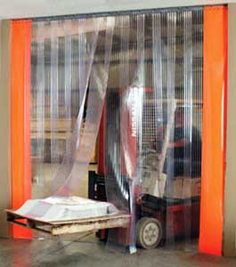
Notes:
About four times the size of a large lecture classrooms the chrome and zinc plating area was sealed off, there were a series of huge dip tanks were the coating layers were added, hoods to vent off the toxic fumes, and air conditioning. Sweet, cool air conditioning. I looked forward to parting the industrial-sized plastic curtain strips and feeling the cool air on my face, then in my deep breathes. But one day, something was terribly wrong.

Slide 8
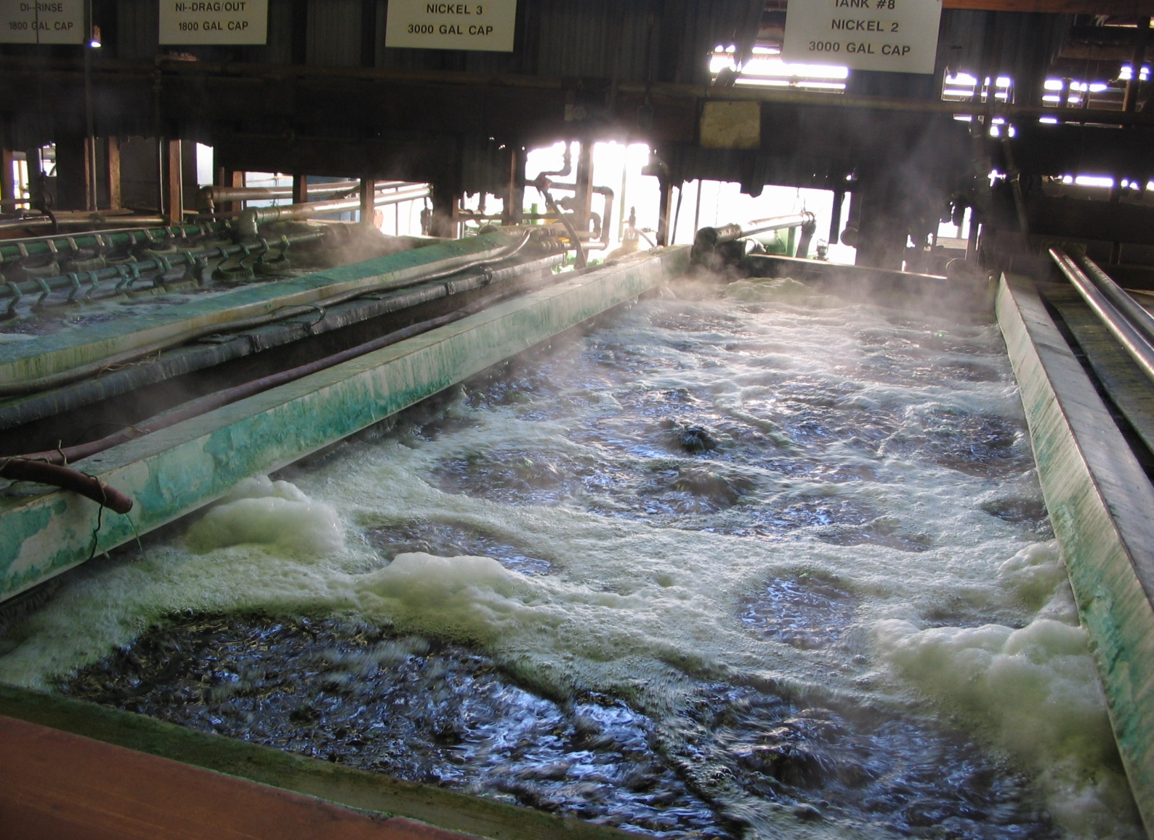
Notes:
After I slid through the plastic strips, my eyes began tearing. The hairs of my nose were burning. The taste of acid washed over my tongue. My upper respiratory system went into full alert warning me of danger. Yet, six employees worked away near the dip tanks. Perhaps protected by their proximity to other hoods, one or two vents were clearly malfunctioning. A toxic fugitive emission filled the air. I yelled above the industrial noise. Something’s wrong. Everyone should get out. “Evacuate the line” I barked.
As six workers, all nonwhite, slowly made their way past me, one worker stared intently into my eyes as he passed and asked: “Where were you twenty years ago.” I was barely 20.

Slide 9
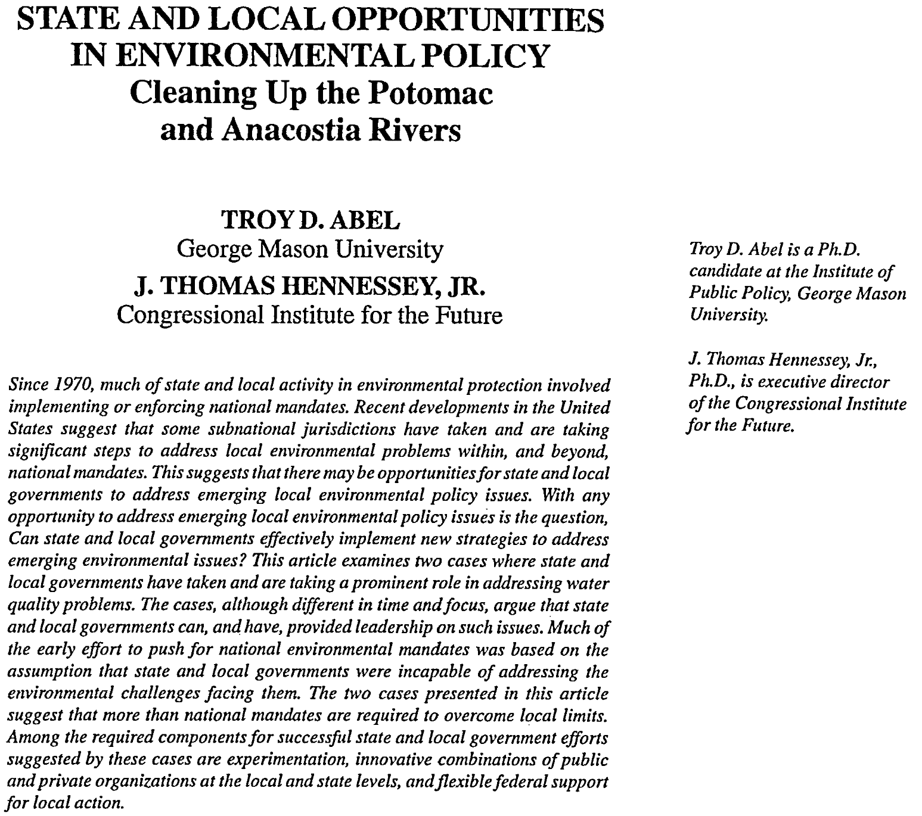
Notes:
A decade after that internship, I published my first scholarly article. I was still a PhD student at George Mason University in Northern Virginia. I had begun to develop an interest in why some communities were developing environmental protection beyond the mandates from existing national laws like the Clean Water Act. Tom and I interviewed local officials who were involved in the cleanups of the Potomac and Anacostia Rivers and in this article, we concluded that both exemplified innovative experimentation in both the public and private sectors. Public administration scholar DeWitt John coined the idea of civic environmentalism based on similar research. Nowhere in this article did we mention environmental justice or toxic racism.
See: John, D., 1994. Civic environmentalism. Issues in Science and Technology, 10(4), pp.30-34.

Slide 10

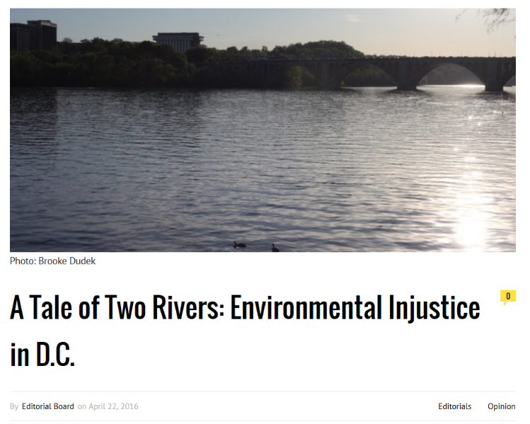
Notes:
Nearly twenty years later, the Georgetown University student newspaper ran this story for this year’s Earth Day (2016). Playing on Dickens’ A Tale of Two Cities, the editorial writers noted the following. “There are stark differences between the Potomac River and the Anacostia River. The first, bordering the south section of our campus, is a source of pride for its community. In the warmer months, its waters are littered with boats of all sizes, its banks occupied by patrons wishing the day away. . .
The same pride and ownership have not been widely bestowed on the Anacostia River, which has, at times, been labeled “D.C.’s forgotten river.” Recent efforts to clean the waters have been stymied by ongoing toxic pollution and by the marginalization of the community along its borders. . . This inequality is a matter of environmental justice, a concept often given lip service, but not widely understood. The Anacostia River’s current state is the product of unjust systemic conditions within our community. In this case, and in many others, the environmental problems in large part arise from discrimination based on race and class. The neighborhood surrounding the Anacostia is largely poor and black. The neighborhood surrounding the Potomac is not.”

Slide 11
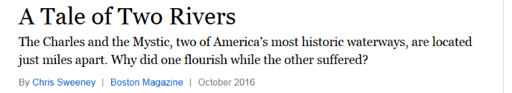
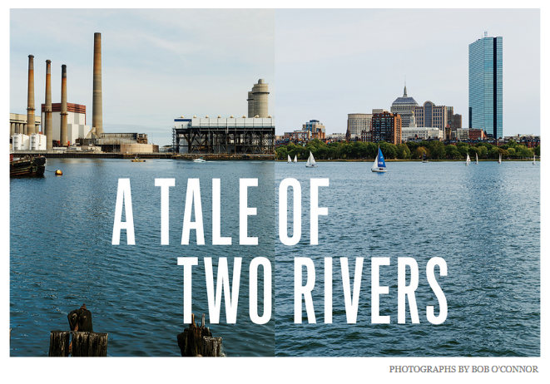
The Dickensesque metaphor keeps echoing
Notes:
Anyone here from Boston?

Slide 12
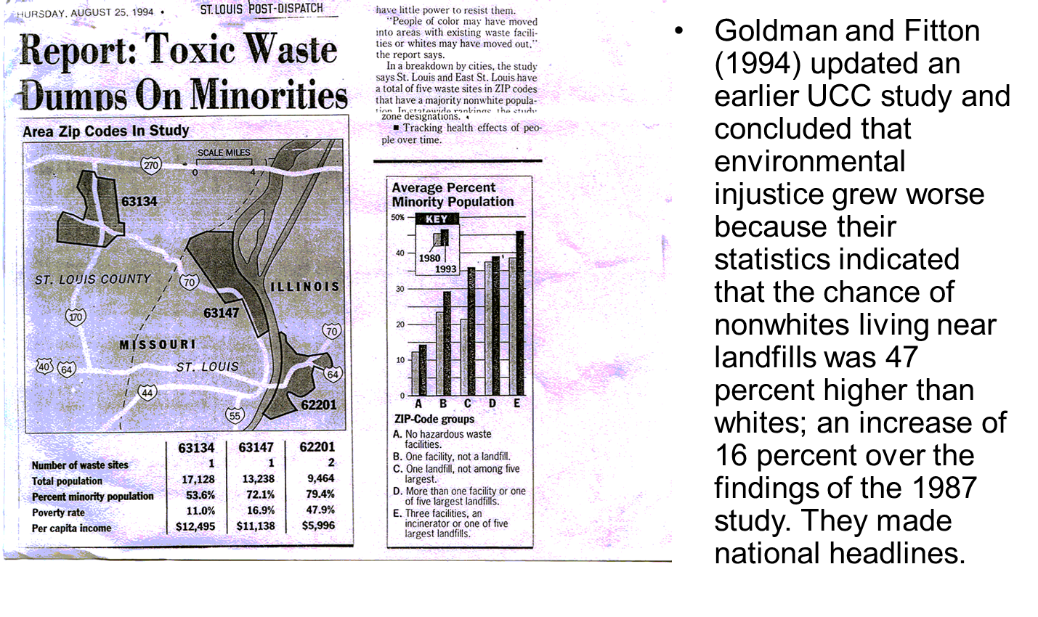
A tale of two riversides
Notes:
Anyone from St. Louis? Ok. I started my academic career there in 1999; five years after the watershed year for environmental justice. 1994.
Goldman and Fitton (1994) updated an earlier United Church of Christ study and concluded that environmental injustice was getting worse in America because their statistics indicated that the chance of nonwhites living near landfills was 47 percent higher than whites; an increase of 16 percent over the findings of the 1987 study. They made national headlines.

Slide 13
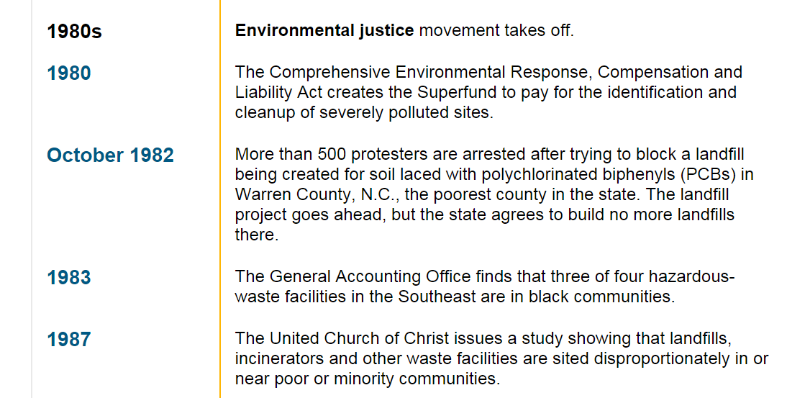
Notes:
Cooper, M. H. (1998, June 19). Environmental justice. CQ Researcher, 8, 529-552. Retrieved from http://library.cqpress.com/

Slide 14
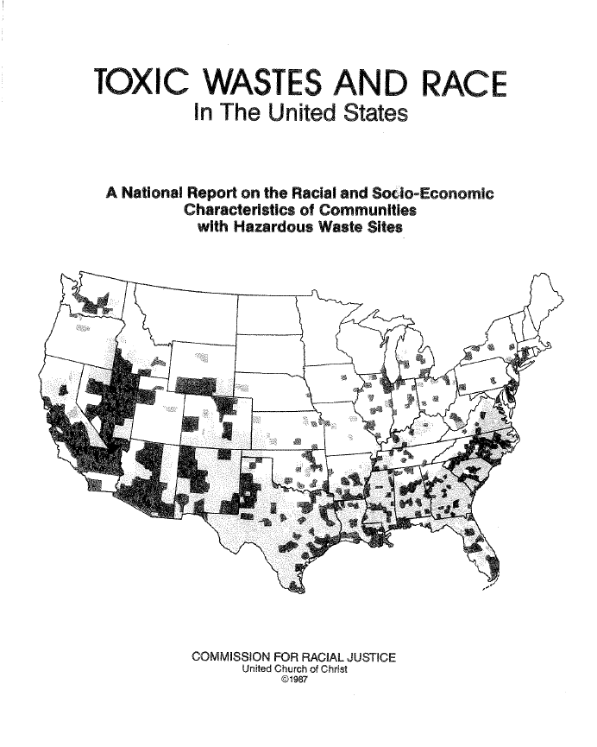
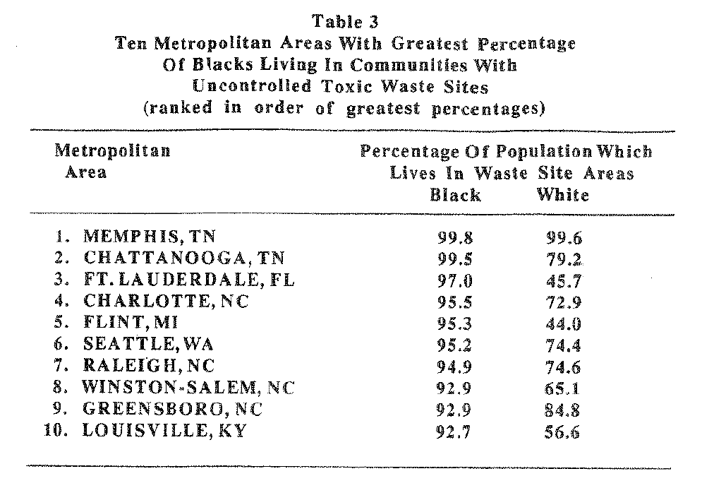

Slide 15
Notes:
There’s Seattle, right next to Flint Michigan.

Slide 16
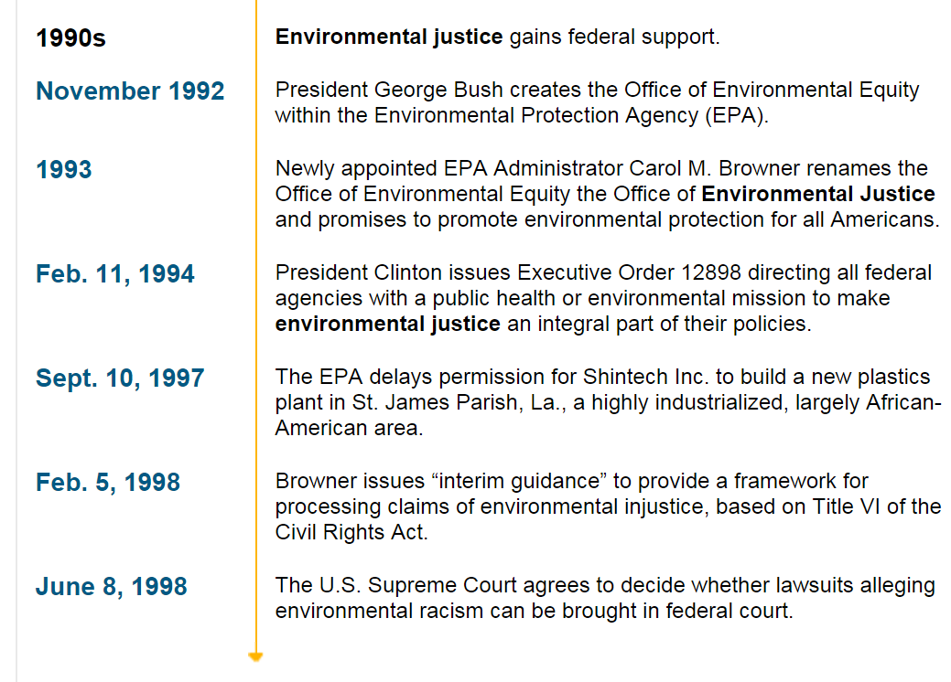
Notes:
Clinton’s executive order could be seen as a coupling of the three streams and environmental justice now joined past policy landmarks like the Clean Air Act, the Clean Water Act, and the Endangered Species Act. However, on eight occasions from 1992 to 1998, Congress failed to enact environmental justice legislation (Ringquist and Clark 1999). Environmental justice initiatives were instead limited to executive branch actions and several subnational efforts, hardly the policy transformation suggested by Kingdon’s original model.

Slide 17
Scientific Racism
Although social scientists have pursued [environmental racism] with the stated goal of contributing to more informed policy making, unspoken political projects lurk beneath the surface of scientific inquiry” (p. 142).
Pulido, Laura. 1996. A CRITICAL REVIEW OF THE METHODOLOGY OF ENVIRONMENTAL RACISM RESEARCH. Antipode 28(2): 142-159.

Slide 18
Scientific Racism
“Instead, the power to claim the existence of [env. Racism] has been appropriated by academics, who by the process of operationalization and adherence to methodological rigor have transformed an inherently complex and contradictory [paradoxical] ideology and set of practices (racism) in an either/or situation….a monolithic understanding of racism” (p. 148).
Pulido, Laura. 1996. A CRITICAL REVIEW OF THE METHODOLOGY OF ENVIRONMENTAL RACISM RESEARCH. Antipode 28(2): 142-159.

Slide 19
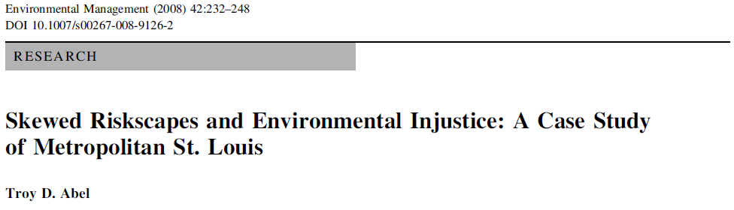
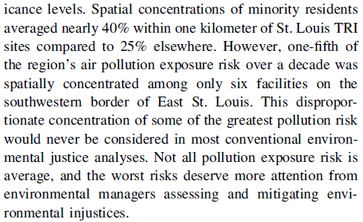
A tale of two riversides
Notes:
In 2008, I joined the debate with this article about metropolitan St. Louis’s skewed riskscape.

Slide 20
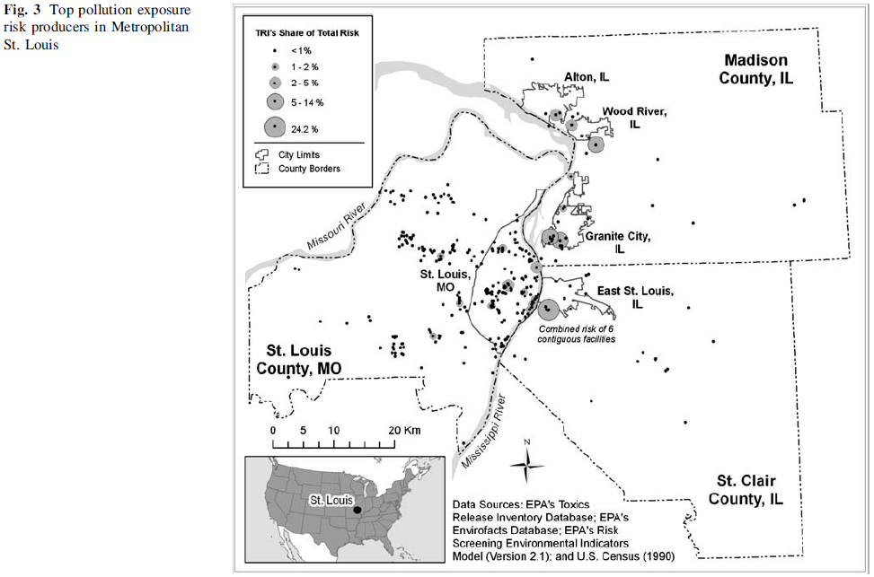
A tale of two riversides
Not all pollution is
Created equally.
Notes:
This study’s analysis diverged from one of the great deficiencies of conventional EJ research that has inhibited its contribution to environmental risk management. The most cited environmental justice studies focus on average cases when more interest may lie in unusual cases (Meier and Keiser 1996). Knowing that, on average, minorities are closer to TRI facilities across metropolitan St. Louis provides neither direction for environmental managers, nor remedies for environmental injustices or risk disparities.

Slide 21
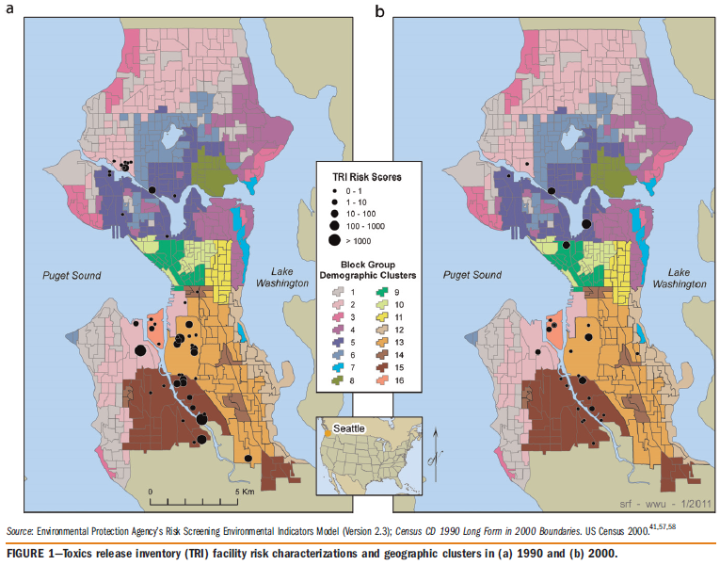
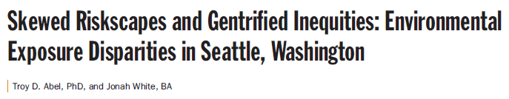
Notes:
I continued to develop an environmental justice research program when I joined WWU in 2006. But I remained illiterate about my white privilege even when my research was revealing systematic patterns of environmental racism. When a social scientist submits research for peer review, the manuscript is most often judged by white academics, using review standards developed by other white authors, and intended for presentations for predominately white readers. That changed on March 17, 2010.

Slide 22
Notes:
I was one of the presenters in the poster session that also had a panel presentation. I joined five other scholars who were mostly white on a raised platform next to a large screen projecting those Seattle maps you just saw. Rows of chairs and two microphones in the aisles were placed below us in the typical public policy hearing arrangement. Experts on high, the public below us.
The audience lined up to ask questions and Marsha Monesterskey representing the Forgotten People Community Development Corporation in Tuba City, AZ began to speak. An activist in Northern Arizona’s Navajo country, and a self-proclaimed Nava-jew, began to recount the environmental injustices they were fighting.

Slide 23
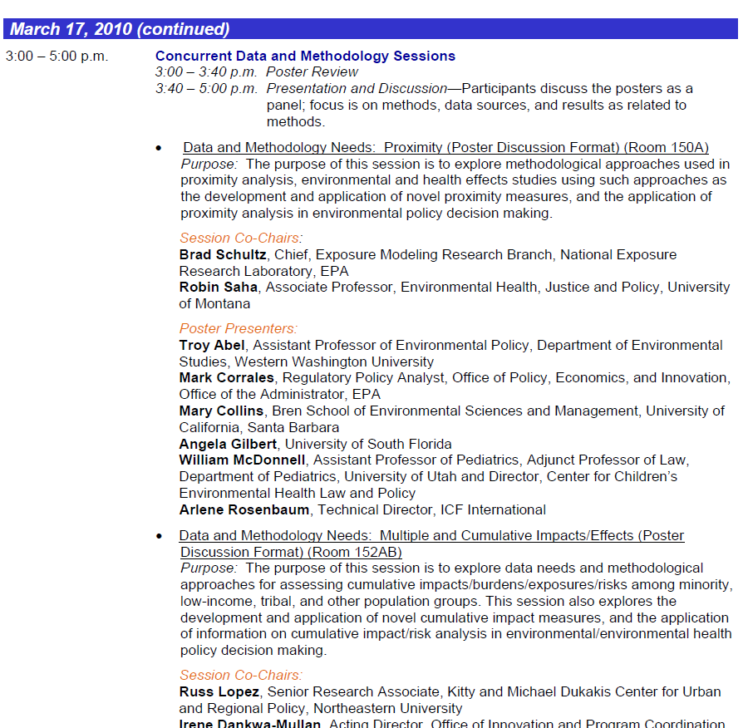
Notes:
The Navajo Nation had proximity to abandoned uranium mining sites. Their community had multiple and cumulative health impacts from a drinking water supply contaminated by radioactive mine tailings.

Slide 24
Notes:
She also spoke about how this community had organizational capacity. That’s why she was attending after all with her colleague Don Yellowman. However, she continued while raising her voice, we can’t make those kind of maps.

Slide 25
Notes:
She was pointing at the large screen and there were our maps. My co-author Jonah White’s maps to be precise. Marsha then asked, will any of you help us? After some uncomfortable silence, I responded that I’d be happy to talk to her over lunch. I suggested she contact the geography departments at Northern Arizona University, Arizona State, or Arizona. I also told her that I’d see if any of my students would be willing to intern with her organization for our Huxley experiential requirement. Two of my undergraduates did and one, the white one, won a national award for his mapping project.

Slide 26

Where we’re from exercise
Past experiences shape our perceptions and reactions.
Understanding your unique background and others can help us see how diversity is a positive asset for our organization.
Notes:
However, not all diversity is equal in our racialized society.

Slide 27
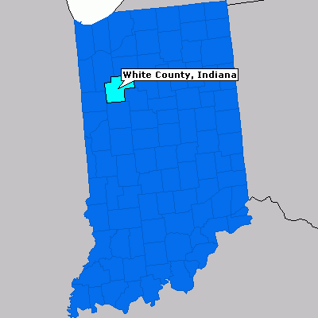
Where we’re from exercise
I am from the _______ (home description… adjective, adjective, sensory detail).
I am from _______ (family tradition) and _______ (family trait), from _______ (name of family member) and _______ (another family name) and _______ (family name).
I’m from _______ (place of birth and family ancestry), _______ (two food items representing your family).
Notes:
I am from a Forrest, pulled from the dead pile of Illinois’s worst tornado at 13
He was a railroadman, and part of Mattoon’s Klan
He married Goldie, Irish-Catholic, mother of my father
I am from Fred who worked for GM, ran a printing press, and sold insurance
He rejected Catholicism, embraced evangelicals
Lost to cancer when I was 12
I am from JoAnn, an Indiana paradox of the nineteen eighties
From German Protestant Rynersons
She celebrated the failure of the Equal Rights Amendment
While starting a business to fight wage inequality
She was a single-mom, a female entrepreneur
Things her church frowned upon
She was gone by my early twenties
Breast cancer and God took her independence
NEXT SLIDE

Slide 28
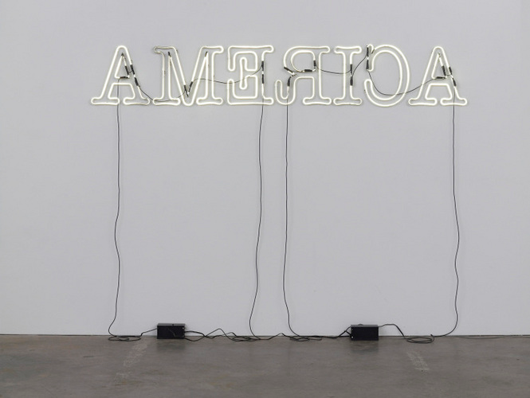
Ruckenfigur by Glenn Ligon, 2009.
Notes:
I am from older siblings polarized by religion and college experience
Taking a side was easier with education, age, and geography
My feet were across one generation without a university degree
Another just figuring out higher education was worth fighting for
We learned of our half-sister in my twenties
Just a few months older than me
I am from Lafayette, Logansport, Mattoon, and Monticello
An arc of roads crossing the center of Illinois and Indiana’s state line
Railroads intersected this land, combines and crops, factories smoked the sky
White county, white churches, white corn
Segregation was preached from the pulpit
The heart of AMƎRICA’s heartland
If you weren’t white, we could look you straight in the eye
And turn our backs on you at the same time
As I was contemplating my racial illiteracy a few years ago, I remembered this National Public Radio (NPR) segment about a Black artist from Harlem.
RUCKENFUGER EXPLANATION. http://www.npr.org/2011/05/08/136022514/glenn-ligon-reframes-history-in-the-art-of-America

Slide 29
Ǝ
Ǝ

